Slide 1
Real Estate Analysis
161242
Nadipelli Amuktha Malyada

Slide 2
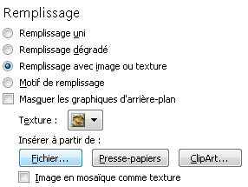
PROBLEM STATEMENT:
Objective:
Development of a Analysis & Reporting System of Real Estate
Abstract of the project:
The project is to develop Analysis & Reporting System of Real Estate
Technology used:
Ab-Initio :- ETL Tool
Pour modifier l’image d'arrière-plan :
Faites un clic droit et cliquez sur Mise en forme de l’arrière-plan
Dans la fenêtre Remplissage, choisissez Remplissage avec image ou texture puis cliquez sur Insérer à partir de : Fichier
Sélectionnez votre image puis cliquez sur Fermer

Slide 3
DATA MODEL IMPLEMENTATION:
We have implemented star schema where the given data-set has a lot of dimensions and some majors so we created a fact table and some dimension tables.

Slide 4
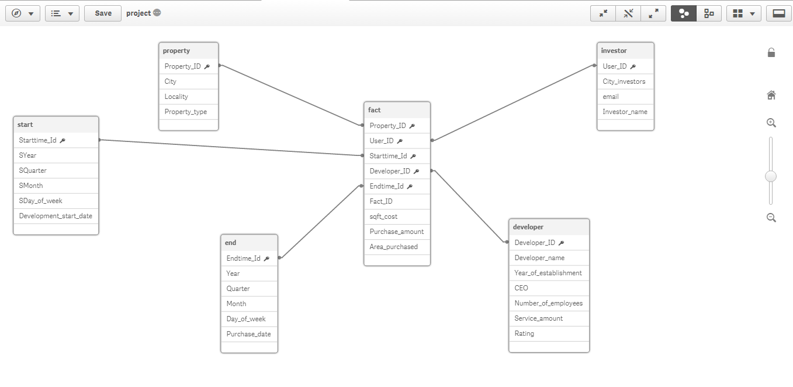
OLAP Schema Diagram:

Slide 5
GIVEN DATA
FIELDS IN GIVEN DATA SET:
Development Start Date
Purchased Date
City
Locality
Property Type
Developer Name
Investor Name
Sq-ft cost
Purchase Amount
Area Purchased

Slide 6
DIMENSION TABLES
Property
Property ID
City
Locality
Property Type
Developer
Developer Id
Developer Name
Year Of Establishment
CEO
Number Of Employees
Service Amount
Rating
Investment
Cities
User_ID
Email
Full Name
Time
Time Id
Year
Quarter
Month
Day of Week
Date
Holiday

Slide 7
Fact Table
Fact ID
Start time ID
End Time ID
Property ID
Developer Id
Investment ID
Sq-ft cost
Purchase Amount
Area Purchased

Slide 8
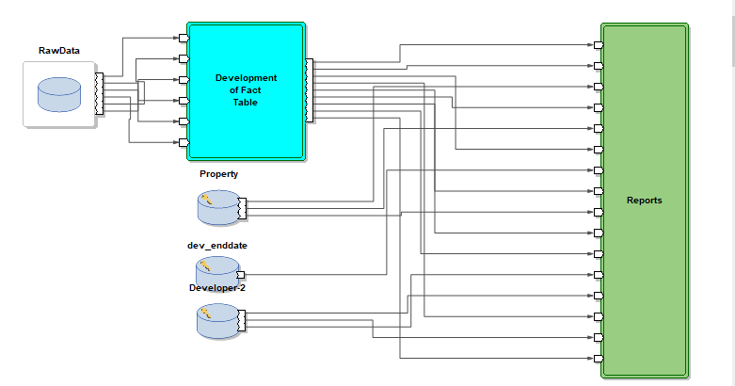
Develop Analysis & Reporting System of Real Estate:

Slide 9
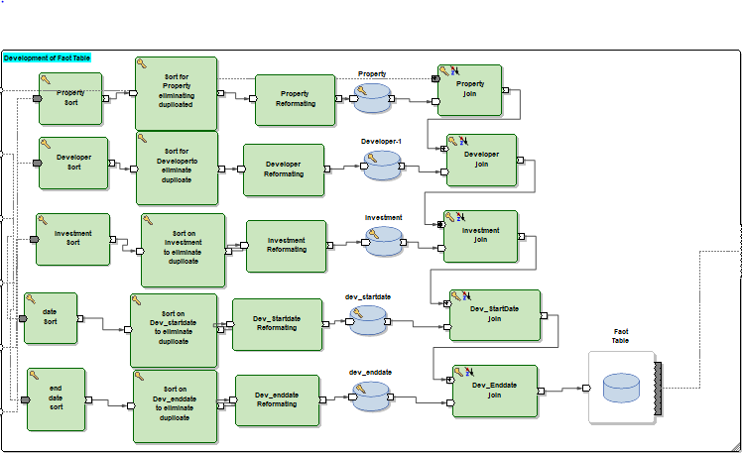
Fact Table Generation:

Slide 10
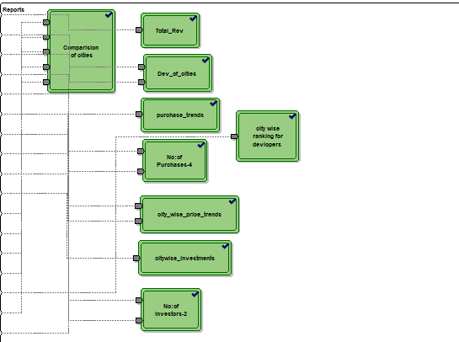
Reports

Slide 11
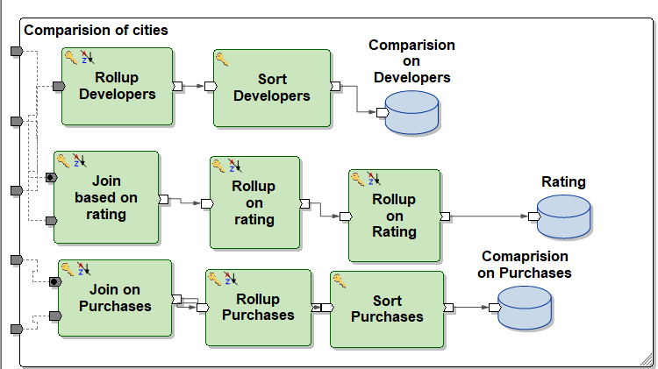
Comparison of different companies:

Slide 12
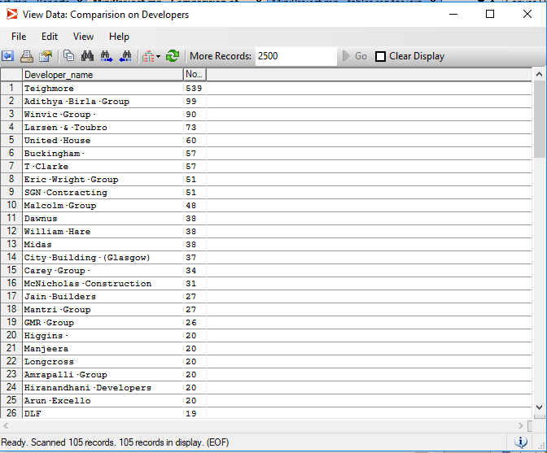
Output file:
Comparison of different companies based on Number of Projects Developed

Slide 13
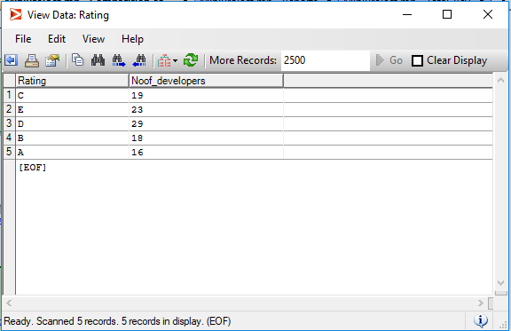
Output file:
Comparison of different companies based on Developers and their Rating.

Slide 14
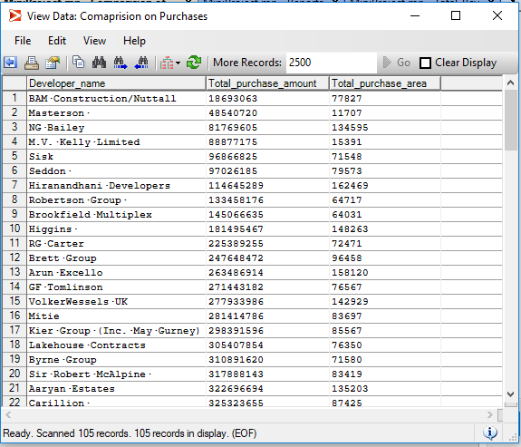
Output file:
Comparison based on Total area purchased and Total Revenue generated.

Slide 15
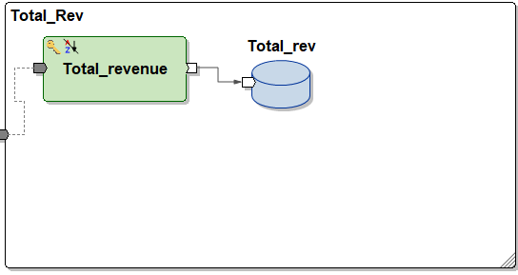
Total Revenue on area purchased:

Slide 16
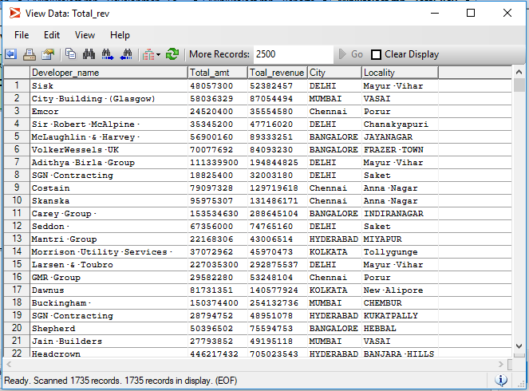
Output file:
Total revenue generated for area purchased in a locality in the city.

Slide 17
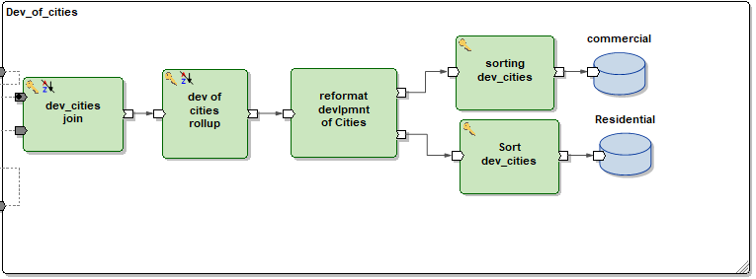
Development of cities residentially and commercially

Slide 18
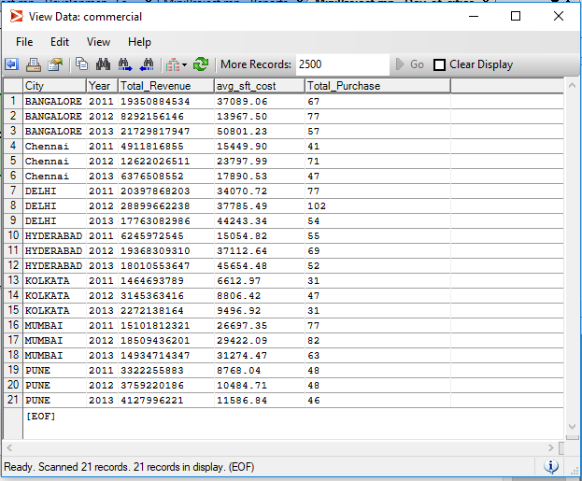
Output file:
City wise development Commercially based on Total Purchases and its Total Revenue, Avg sq ft Cost

Slide 19
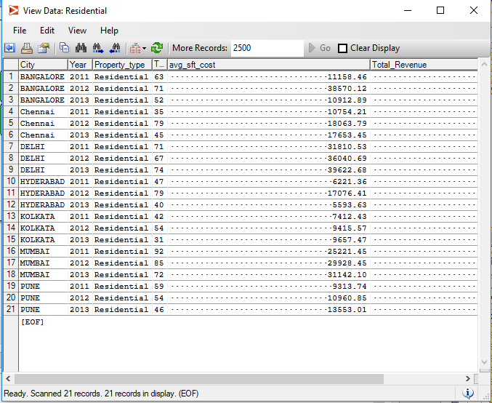
Output file:
City wise development Residentially based on Total Purchases and its Total Revenue, Avg sq ft Cost

Slide 20
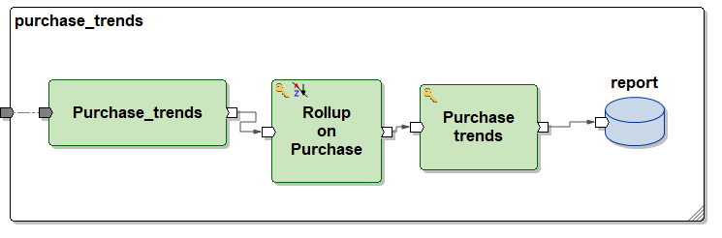
Purchase Trends

Slide 21
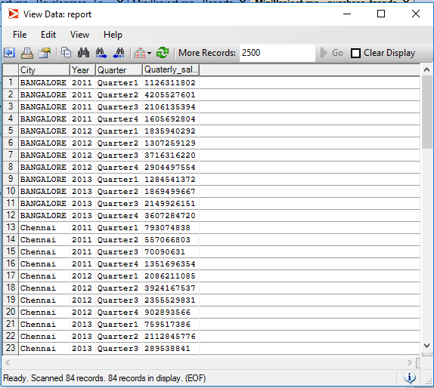
Output file:
Annual Purchase Trends in the city for every Quarter.

Slide 22
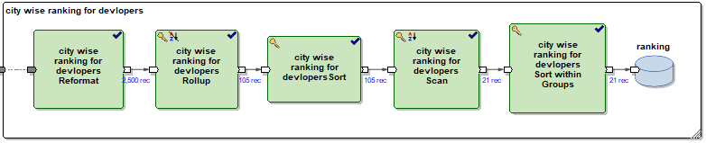
City-wise Ranking of Developers:

Slide 23
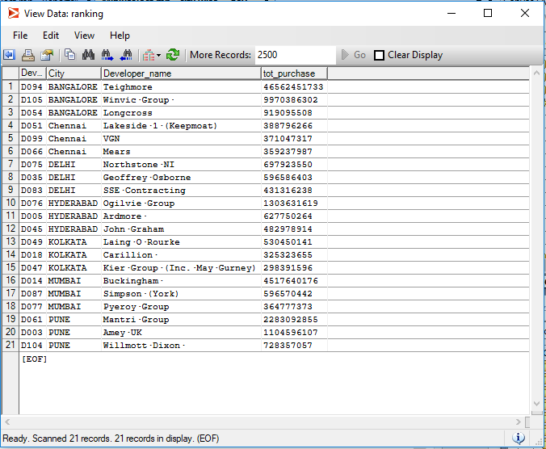
Output file:
City Wise Ranking of Developers based on the Total Sales.

Slide 24
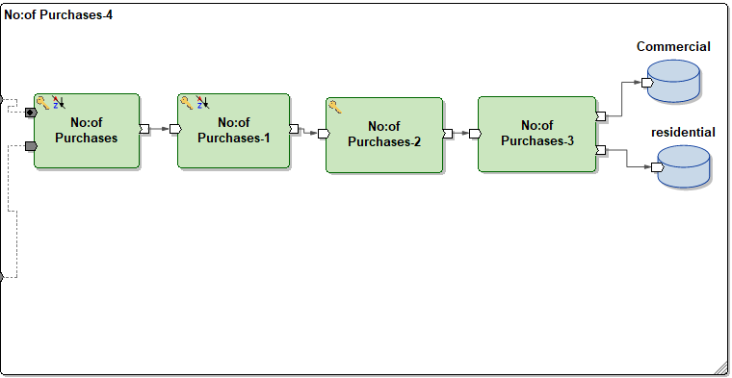
Number of purchases in cities

Slide 25
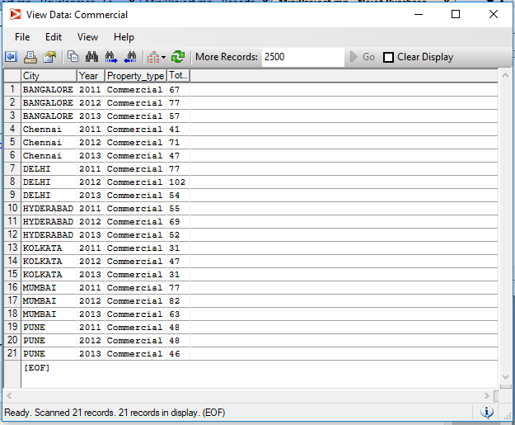
Output file:
Total Number of Commercial Property Purchases in a City Annually.

Slide 26
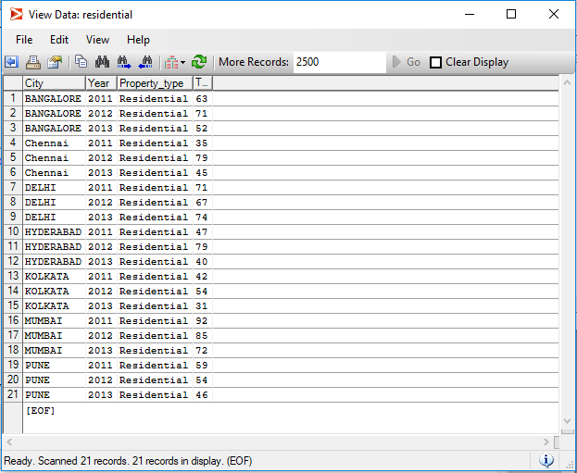
Output file:
Total Number of Residential Property Purchases in a City Annually.

Slide 27
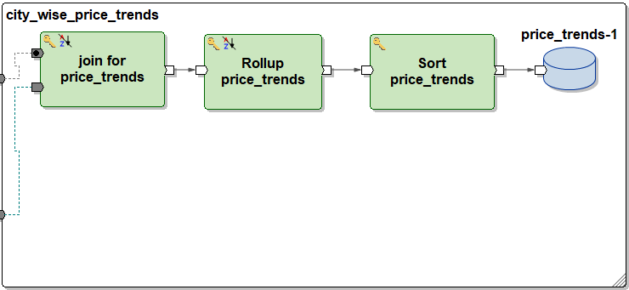
City-wise price trends

Slide 28
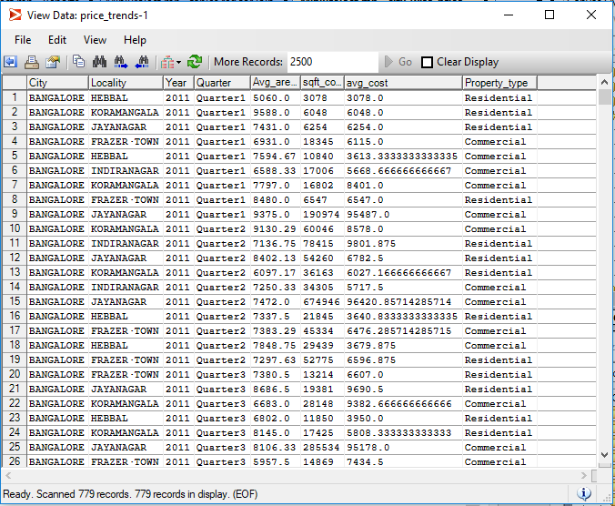
Output file:
Quarterly Price Trends in every Locality in a City taken Annually based on Sq. Cost, Avg Area purchased and Avg Sq_ft cost

Slide 29
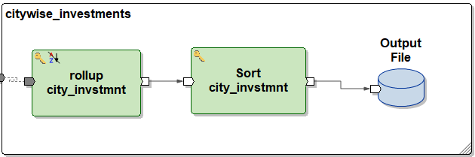
City-wise assessment of Investments

Slide 30
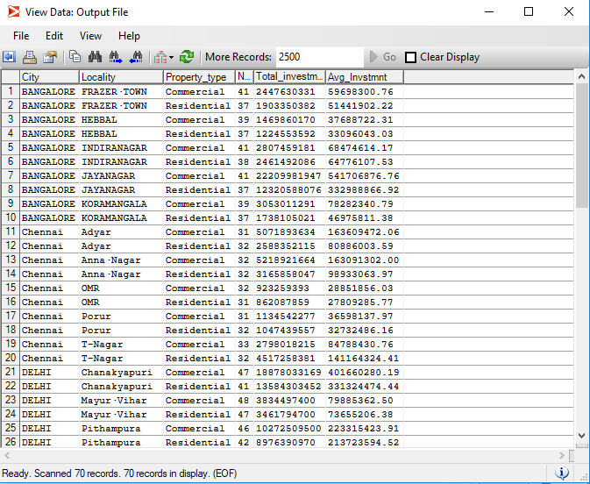
Output file:
City wise assessments of investments in commercial and residential property based on Number of investors,Total Investment and average investment.

Slide 31
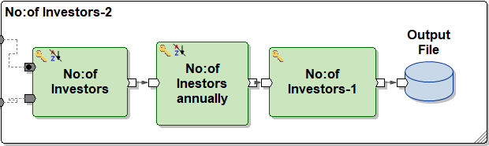
Number of Investors annually for every City

Slide 32
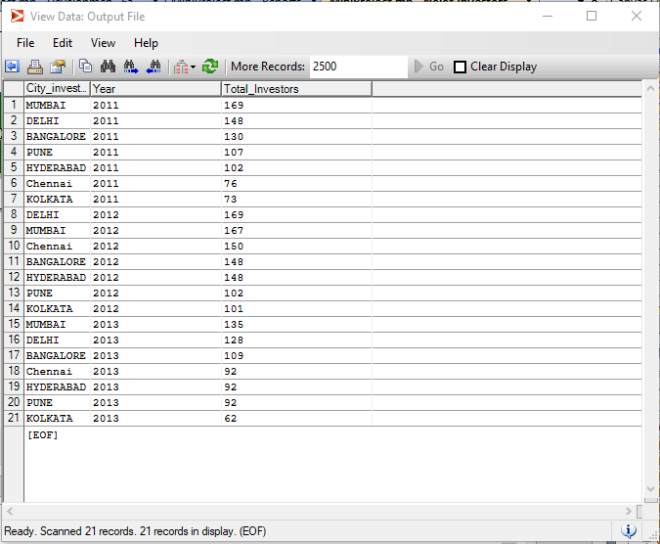
Output file:
Number of Investors Annually for every city.

Slide 33
THANK YOU!!!

